Slide 1
Chapter 13 Traffic Shaper

Slide 2
Traffic Shaper
Two Traffic Shaper
  Leaky Bucket Algorithm
  Token Bucket Algorithm

Slide 3
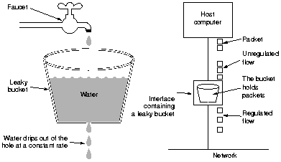
Leaky Bucket Algorithm

Slide 4
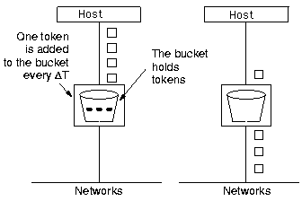
Token Bucket Algorithm

Slide 5

Example—Simulation Scenario

